Slide 1



MARATHON ASSET MANAGEMENT
CORNELL CFEM CAPSTONE 2026
Marathon Project Meeting
Pipeline Review & Subindex Construction
SPONSOR: Jason Foster
ADVISOR: Sasha Stoikov
TEAM: Alex Lee, Max Yap, Minxi Lin, Yung Lee, Olivia Mei
DATE: September 10, 2026

Slide 2
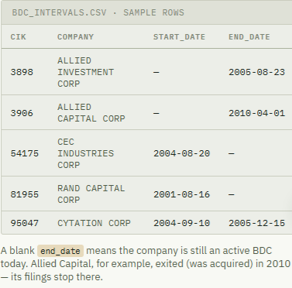
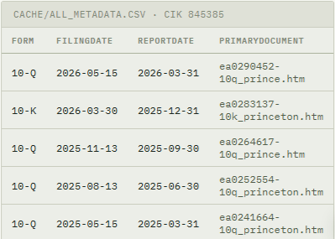
MARATHON ASSET MANAGEMENT
Introduction
CORNELL CFEM CAPSTONE 2026
N-54A/N-54C filings establish who belongs in the BDC universe and when
  They provide the CIKs used to retrieve each BDC’s periodic financial disclosures.
10-K/10-Q filings contain the BDC’s investment schedule: its reported positions, loan terms, and valuations.

Slide 3
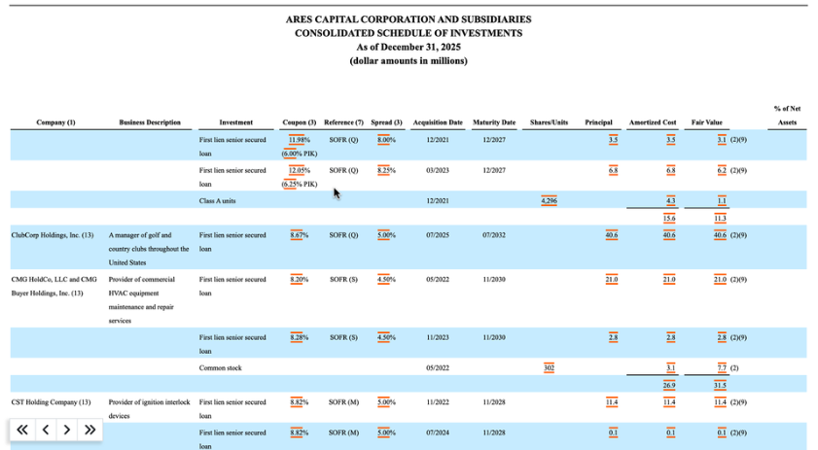
MARATHON ASSET MANAGEMENT
Data Example
CORNELL CFEM CAPSTONE 2026

Slide 4
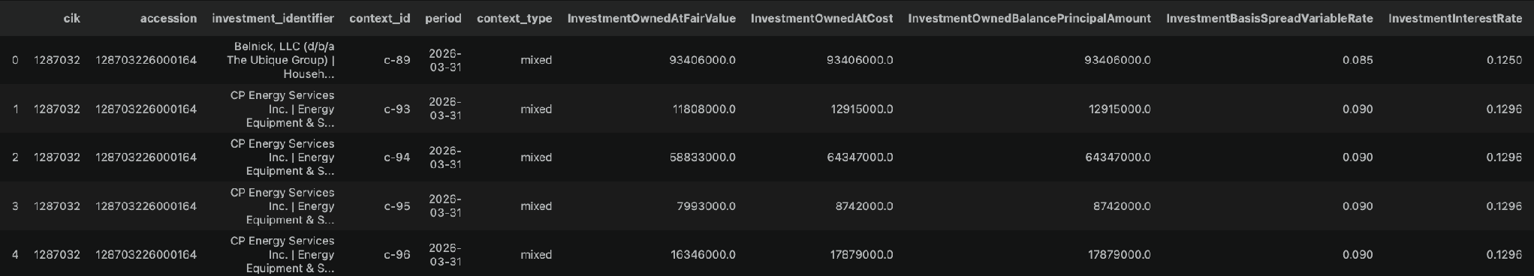
MARATHON ASSET MANAGEMENT
Data Example
CORNELL CFEM CAPSTONE 2026

Slide 5
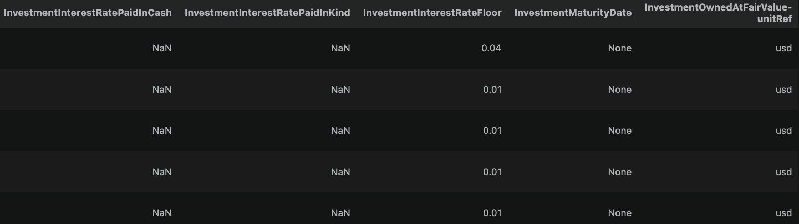
MARATHON ASSET MANAGEMENT
Data Example
CORNELL CFEM CAPSTONE 2026
Maturity Date is often not available -> difficult to do Bond DCF and duration analysis (~73% missing)
But does not prevent index construction, can still use the BDC's reported fair value

Slide 6
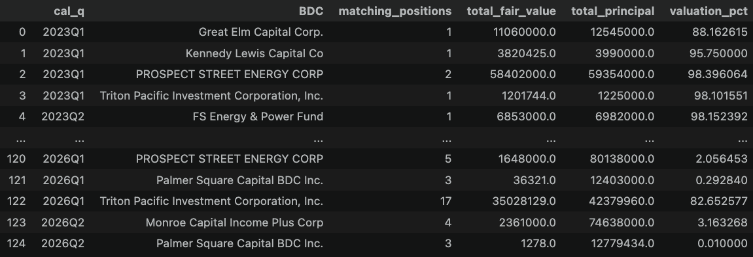
MARATHON ASSET MANAGEMENT
Case Study
CORNELL CFEM CAPSTONE 2026
First Brands

Slide 7
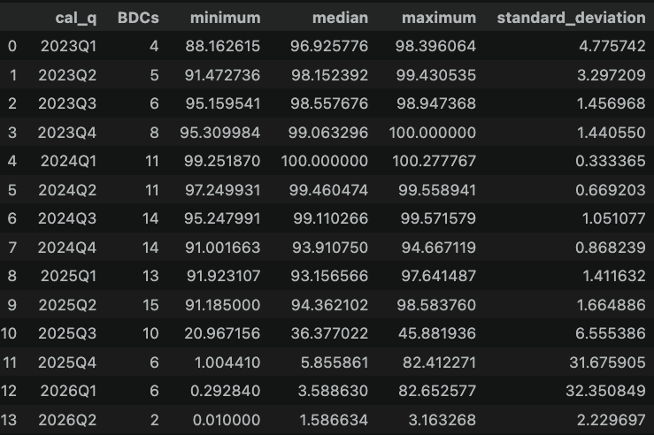
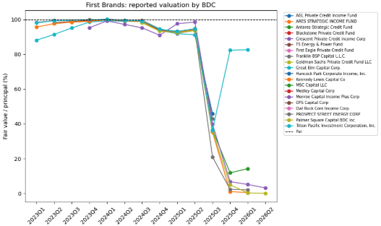
MARATHON ASSET MANAGEMENT
Case Study
CORNELL CFEM CAPSTONE 2026

Slide 8
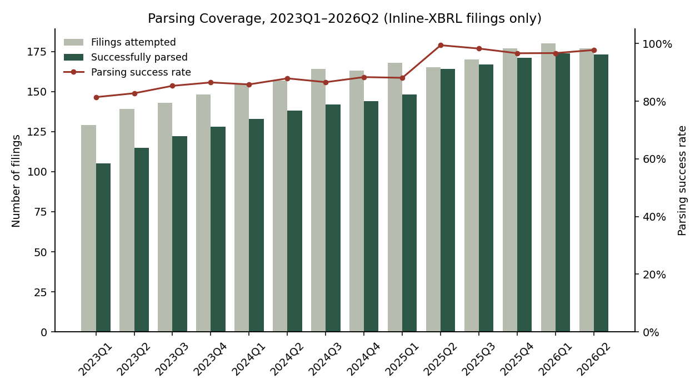
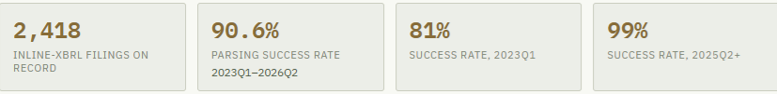
MARATHON ASSET MANAGEMENT
Parsing Coverage
CORNELL CFEM CAPSTONE 2026

Slide 9
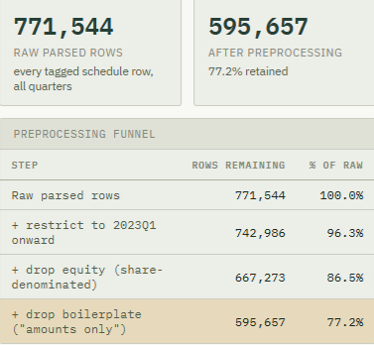
MARATHON ASSET MANAGEMENT
Data Coverage (Preprocessing)
CORNELL CFEM CAPSTONE 2026
Restrict to the index’s coverage window
  2023Q1 onward
Drop share-denominated rows
  Retain rows with InvestmentOwnedBalanceShares == NA
Drop rows with a context tag “amounts_only”
  This can be moved to data cleaning process, but it was included in the preprocessing pipeline

Slide 10
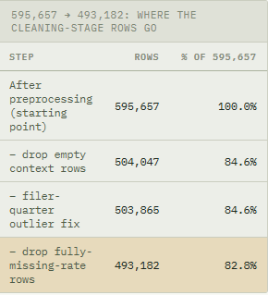
MARATHON ASSET MANAGEMENT
Data Coverage (Cleaning)
CORNELL CFEM CAPSTONE 2026
Drop rows with context tag == “empty”
  neither “terms_only” (spread/rate/maturity) nor “amounts_only” (cost/fair value/principal)
Drop quarter outliers
  A filer’s whole quarter is flagged and dropped when its total fair value is more than 20 times the median of filer’s own other quarters
  Handles the case when fair values, principals, and costs are all tagged with a wrong scale (systematic unit tagging error on the filing level)
  Only 182 rows drop (0.03% of the total rows)
Drop fully-missing-rate rows
  When all four rate fields (spread, total rate, PIC rate, PIK rate) are empty

Slide 11
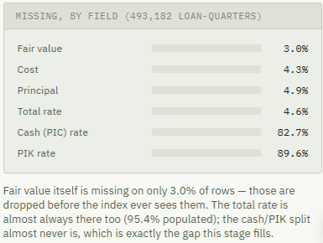
MARATHON ASSET MANAGEMENT
Data Coverage (Cleaning)
CORNELL CFEM CAPSTONE 2026

Slide 12
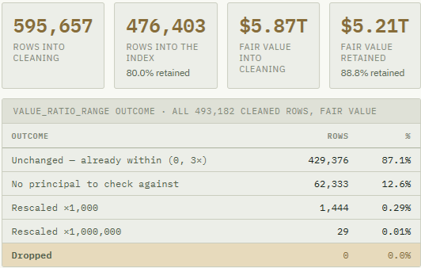
MARATHON ASSET MANAGEMENT
Data Coverage (Cleaning)
CORNELL CFEM CAPSTONE 2026

Slide 13
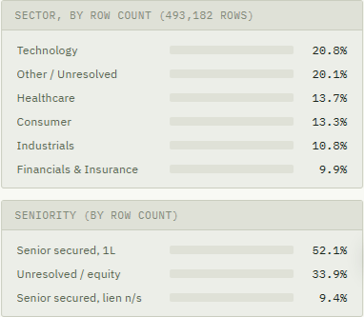
MARATHON ASSET MANAGEMENT
Sector & Seniority Coverage
CORNELL CFEM CAPSTONE 2026

Slide 14
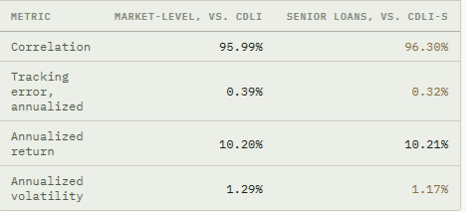
MARATHON ASSET MANAGEMENT
Updated CDLI Index Construction
CORNELL CFEM CAPSTONE 2026

Slide 15
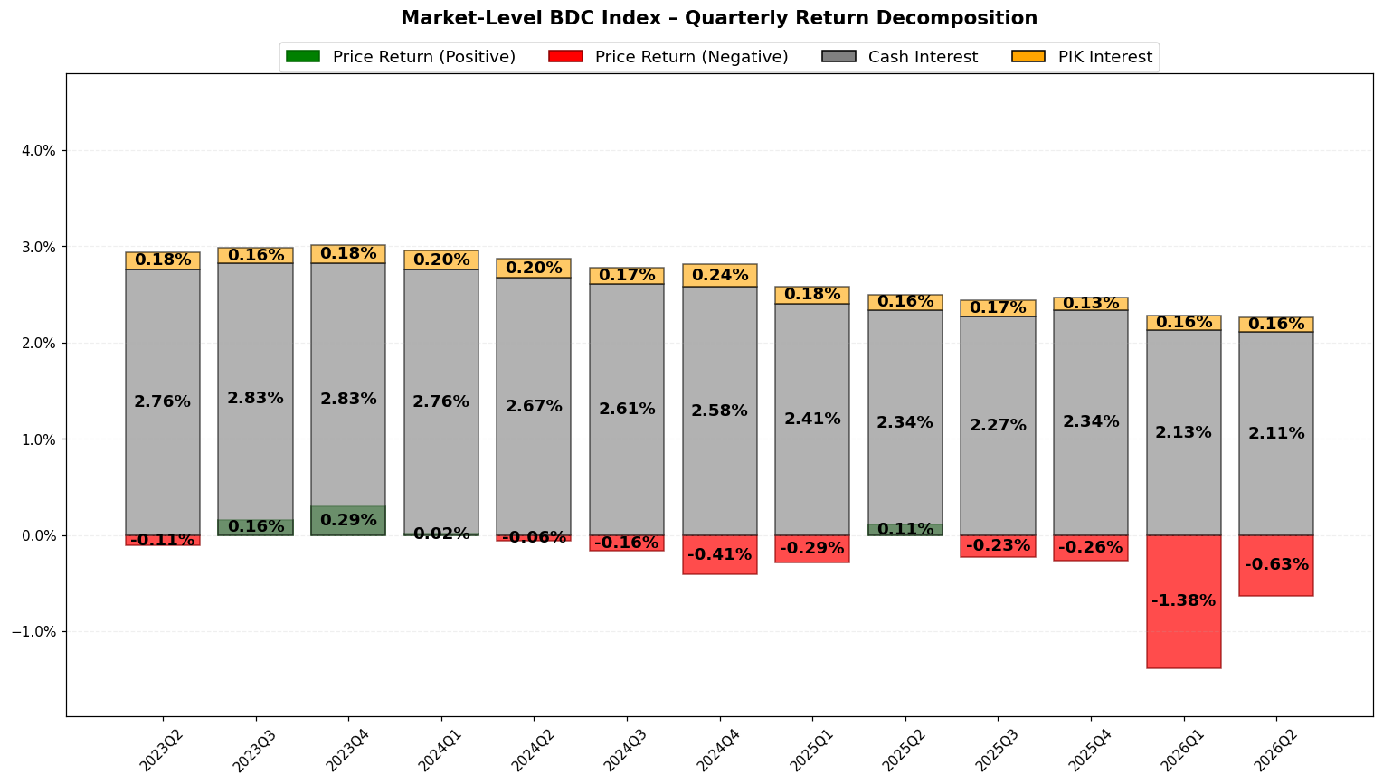
MARATHON ASSET MANAGEMENT
Subindex Construction
CORNELL CFEM CAPSTONE 2026

Slide 16
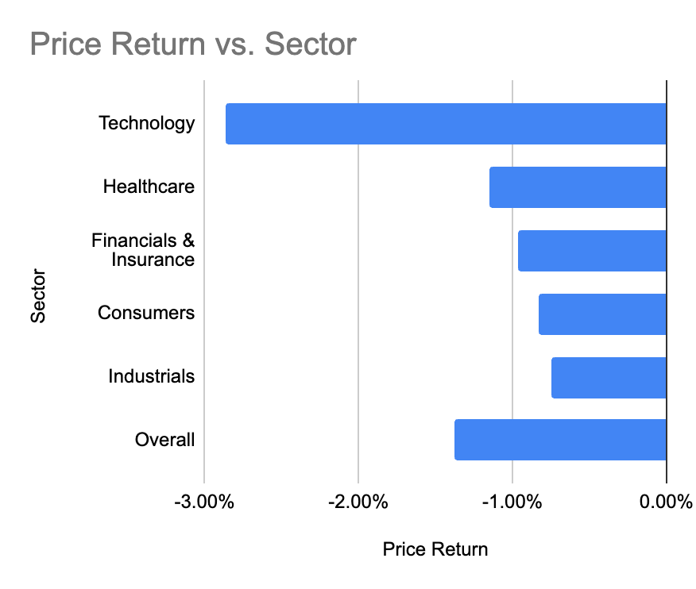
MARATHON ASSET MANAGEMENT
Subindex Construction
CORNELL CFEM CAPSTONE 2026
Top-5 Sectors - 2026Q1 Decomposition
Sector | Count | Price Return | Cash Interest | PIK Interest
Technology | 98,841 | -2.86% | 2.08% | 0.13%
Healthcare | 65,071 | -1.15% | 2.05% | 0.24%
Consumers | 63,661 | -0.83% | 2.21% | 0.22%
Industrials | 51,031 | -0.75% | 2.18% | 0.13%
Financials & Insurance | 46,818 | -0.96% | 2.08% | 0.19%
Overall | 476,403 | -1.38% | 2.13% | 0.16%

Slide 17
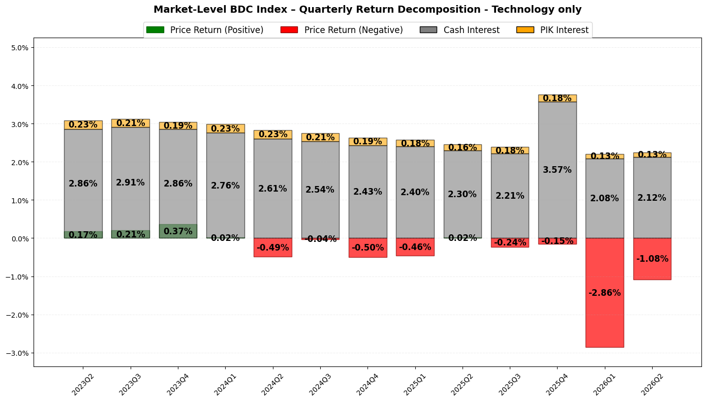
MARATHON ASSET MANAGEMENT
Subindex Construction
CORNELL CFEM CAPSTONE 2026
Technology: Sector-Specific Repricing
Price Return: -2.18%
  The weakest result among the top-5 sector subindices: the decline was 148 bps below the overall BDC index price return of -1.38%.
  The negative price return continued into 2026Q2 at -1.08%, suggesting that the repricing was not limited to a single quarter.
Market Context
  MSCI: the early-2026 listed BDC selloff was partly driven by software-specific repricing.
  Golub Capital: software loans declined much more sharply than non-software loans in the broadly syndicated loan market during Q1 2026.

Slide 18
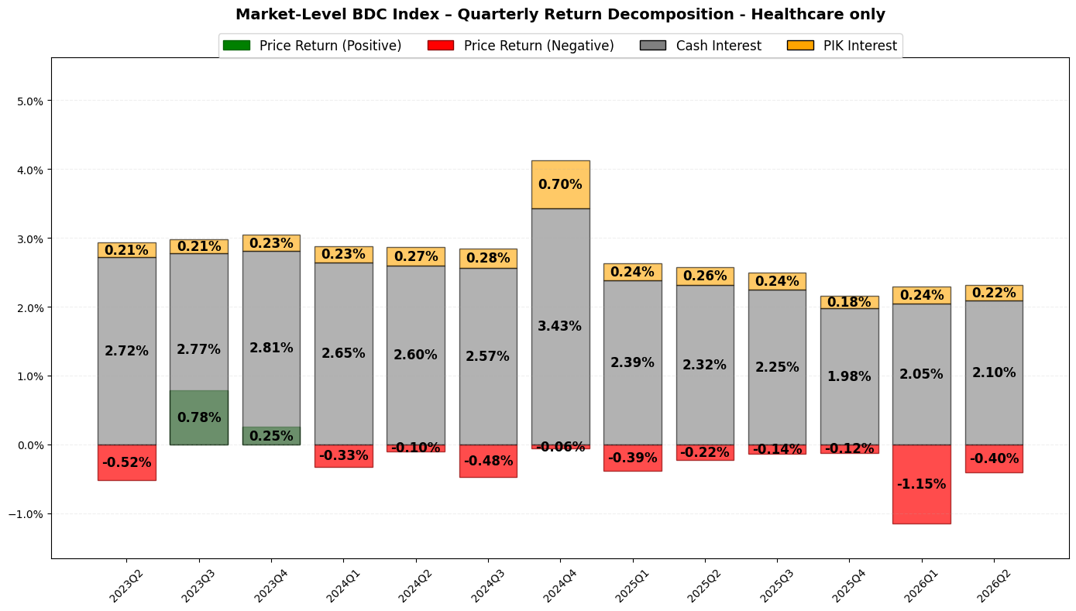
MARATHON ASSET MANAGEMENT
Subindex Construction
CORNELL CFEM CAPSTONE 2026
Healthcare: Persistent Negative Price Returns
Price Return: -1.15%
  The second-weakest result among the top-5 sector subindices in 2026Q1.
  Repeated negative price returns: suggests more persistent markdown pressure rather than a short-term shock.
PIK Interest / Credit-Risk Signal
  Highest observed PIK interest among the top-5 sectors, reaching 0.70% in 2024Q4.
  Elevated PIK interest may indicate borrower cash-flow pressure.
.

Slide 19
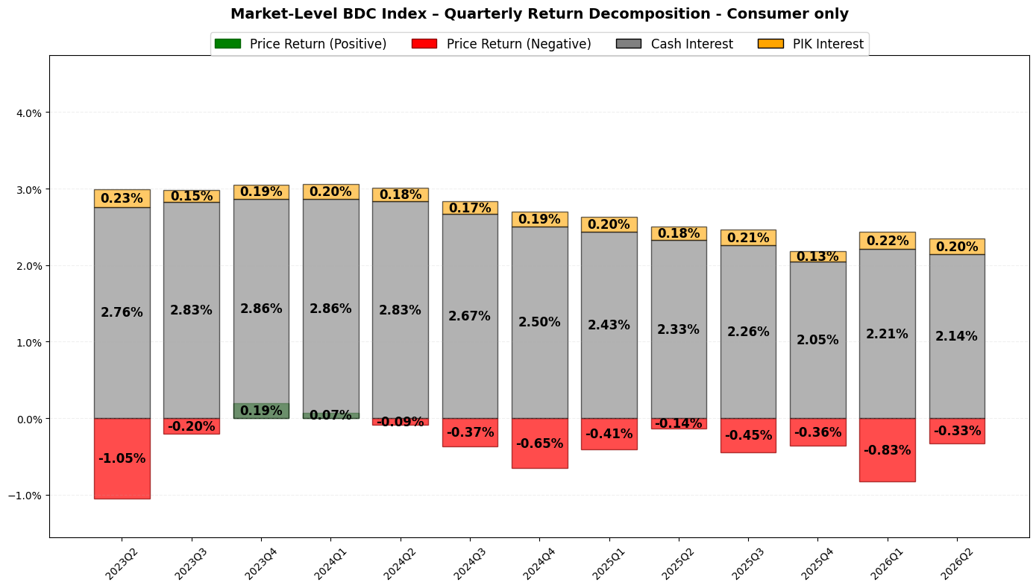
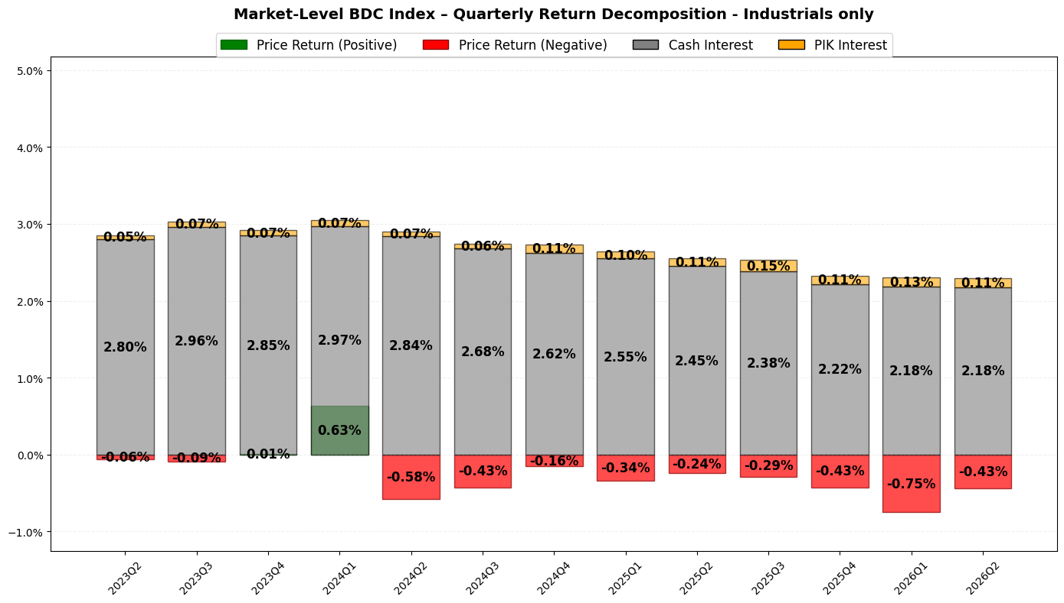
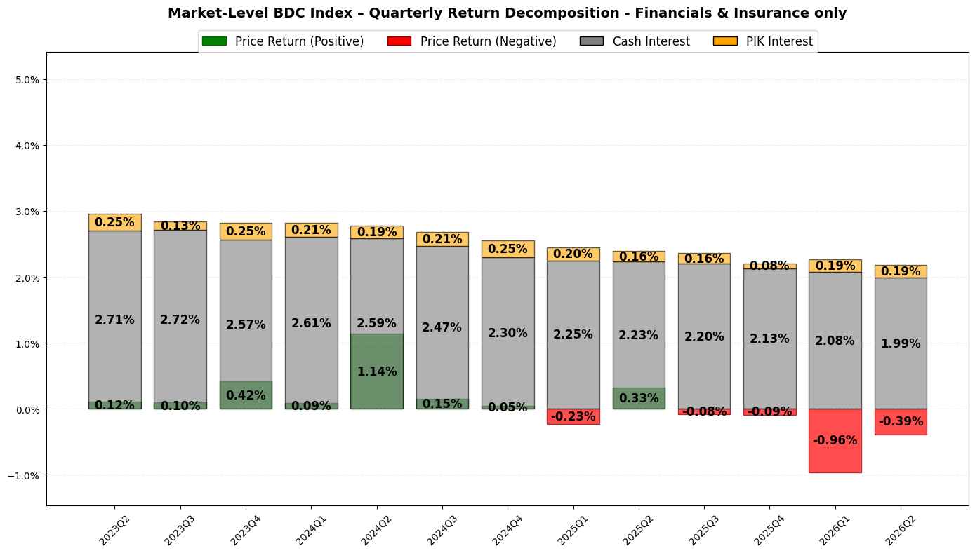
MARATHON ASSET MANAGEMENT
Subindex Construction
CORNELL CFEM CAPSTONE 2026
Consumers, Industrials, and Financials & Insurance
Consumers
  2026Q1 Price Return: -1.15%
  Cash interest declined gradually – weaker income contribution over time
Industrials
  2026Q1 Price Return: -0.75%
  Relatively stable
Financials & Insurance
  2026Q1 Price Return: -0.96%
  Strong performance in 2024 - mixed performance over time

Slide 20
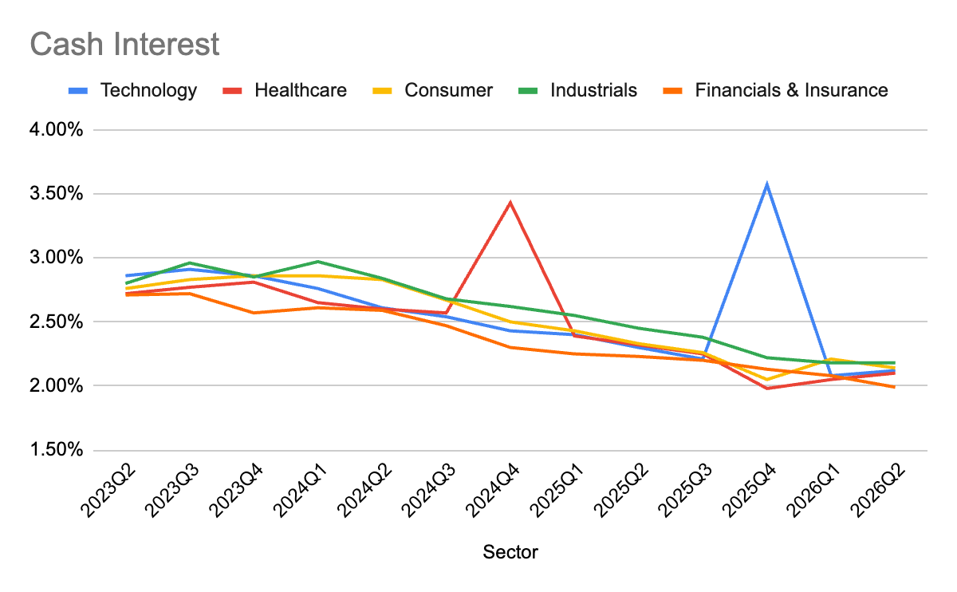
MARATHON ASSET MANAGEMENT
Subindex Construction
CORNELL CFEM CAPSTONE 2026
Cash Interest: broad, relatively uniform decline across sectors
Broad Decline Across Sectors
  Cash-interest returns declined across all top-5 sectors from roughly 2.7%–3.0% in 2023 to around 2.0%–2.2% by 2026Q2.
  Market-wide decline in income contribution rather than a sector-specific pattern.
Spikes: temporary and do not reverse the overall declining trend.
Cash Interest: provides less sector differentiation than price return.

Slide 21
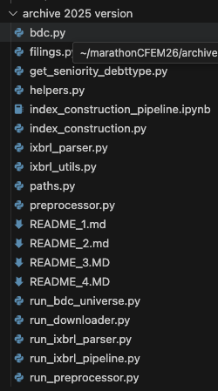
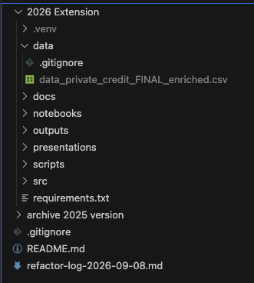
MARATHON ASSET MANAGEMENT
Refactor of Codebase
CORNELL CFEM CAPSTONE 2026
Reorganised flat directory into a layered structure
Modular Code
  Separating library code, orchestration scripts, notebooks, docs, generated outputs, and presentation decks

